Slide 1
LOGOS
2024 Quarter 4 Lesson 3

Slide 2
In the beginning was the Word,
John 1:1

Slide 3
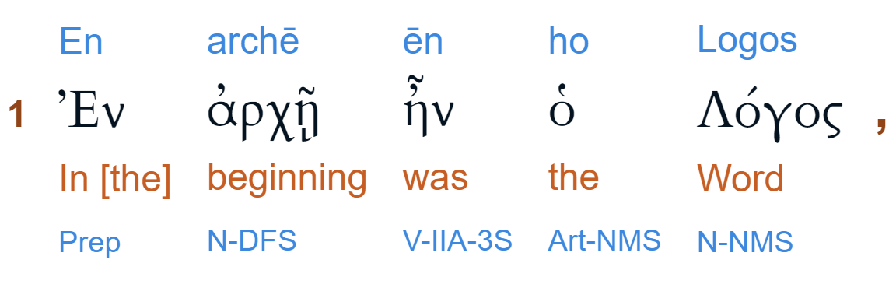
In the beginning was the Word,
John 1:1

Slide 4

In the BEGINNING
The account of creation opens with the equivalent Hebrew words.

Slide 5
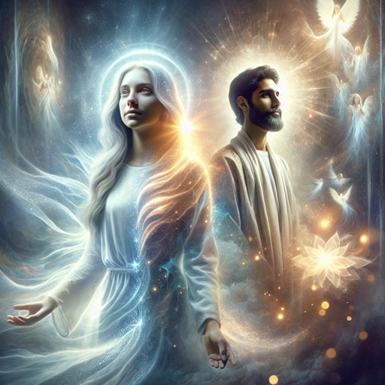
In the BEGINNING
As Genesis 1 sets forth the nature of creation and the fact that man was originally formed in the image of God,

Slide 6

In the BEGINNING
so the prologue to the Gospel of John sets forth the nature of the Creator (v.1-4)

Slide 7
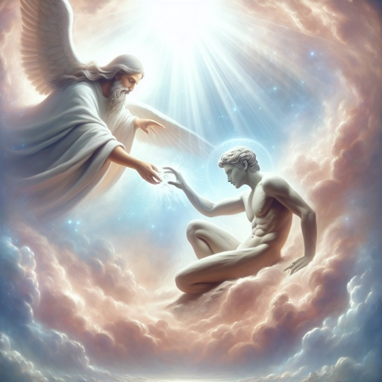
In the BEGINNING
and the means by which God purposed to make possible the re-creation of His image in man (vs. 5-14).

Slide 8

In the BEGINNING
Genesis 1:1 refers to “the beginning” of this world. But the “Word” of John 1:1-4 is the Creator of all things, and therefore predates “the beginning” of Genesis 1:1.

Slide 9

In the BEGINNING
Thus “the beginning” of John 1:1 is prior to “the beginning” of Gen. 1:1. When everything that had a beginning began, the Word already “was.”

Slide 10
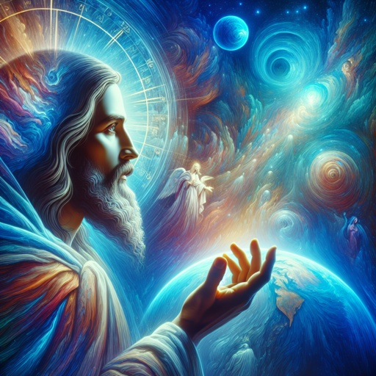
…was the WORD,
The word here translated “was” is the Greek ἦν, or ēn. It’s a form of the verb eimi, “to be,” expressing continuity of existence, or being.

Slide 11
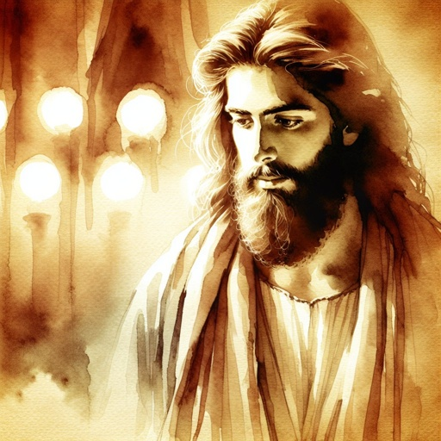
…was the WORD,
The Word was, throughout all eternity; He never became such. But, in time, the Word was made [literally, “became,” egeneto, a form of ginomai, “to become] flesh.

Slide 12

…was the WORD,
Thus Christ has ever been God, but, in contrast, He became man (John 1:14, Phil. 2:7).

Slide 13
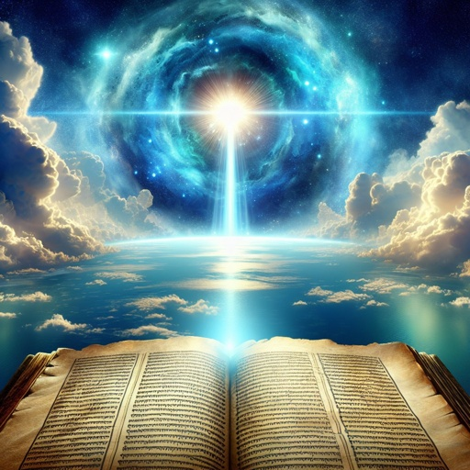
…was the WORD,
Thus both in the words and in their form John stresses the continuous, timeless, unlimited existence of Christ prior to His incarnation.

Slide 14

…was the WORD,
In eternity past, there was no point before which it could be said that the Word was not. The Son was “with the Father from all eternity” (AA 39).

Slide 15

…was the WORD,
The word ēn occurs three times in John 1:1, first of the eternity of the Word, then of His eternal fellowship with the Father,

Slide 16

…was the WORD,
and finally of His eternal equality of nature with the Father. Verse 2 reaffirms the duration of this state of being throughout all eternity.

Slide 17
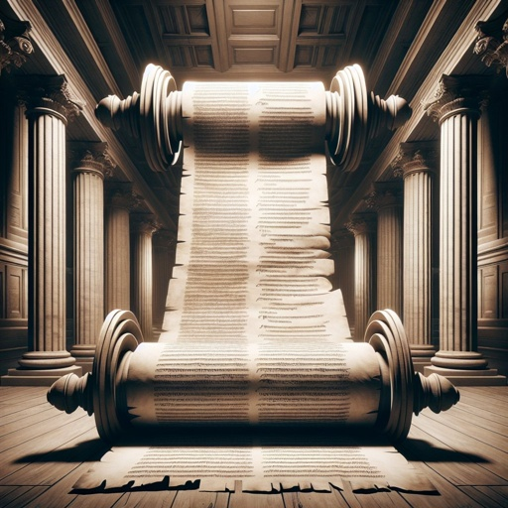
…was the WORD,
“WORD” is a translation of the Greek logos, meaning (according to the SDA Commentary) “utterance,” “saying,” “speech,” “narrative,” “account,”

Slide 18
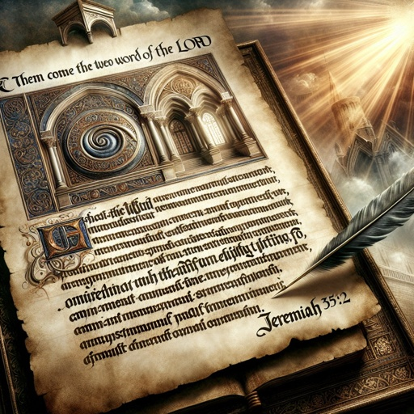
…was the WORD,
“treatise,” with emphasis on the systematic, meaningful arrangements of the thoughts thus expressed.

Slide 19
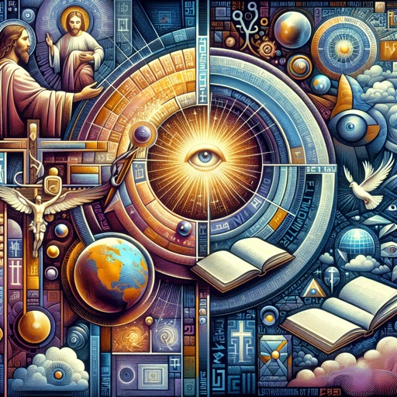
…was the WORD,
In the everyday language of the first century AD, logos commonly meant "word," "speech," "reason," or "discourse."

Slide 20

…was the WORD,
It referred to verbal expression or communication, as well as the rational thought behind it.

Slide 21

…was the WORD,
For example, people might use logos to refer to a spoken argument or conversation.

Slide 22
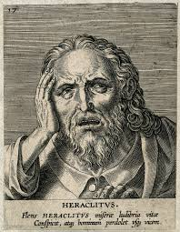
…was the WORD,
In Greek philosophy, especially from thinkers like Heraclitus (c. 500 BC), logos had a more abstract and profound significance.

Slide 23
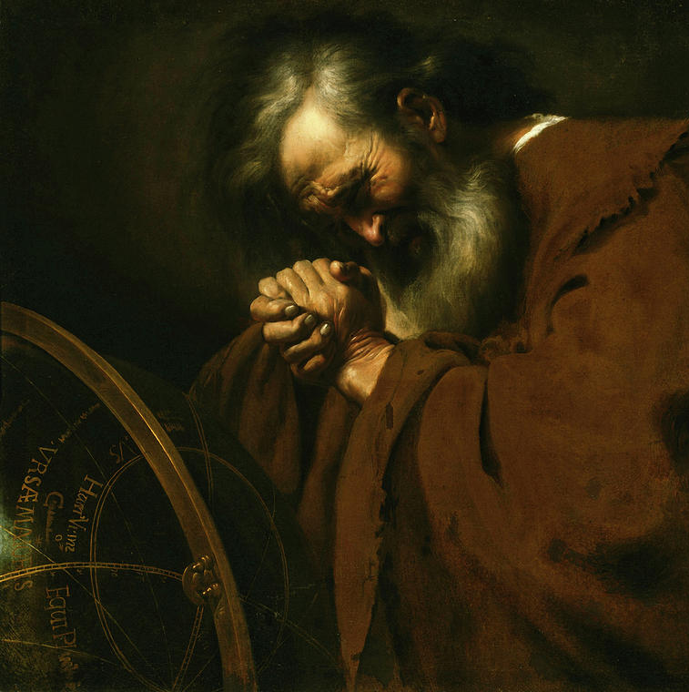
…was the WORD,
Heraclitus used logos to describe the rational principle that orders the universe.

Slide 24

…was the WORD,
In this context, it referred to the underlying reason or logic governing all things.

Slide 25
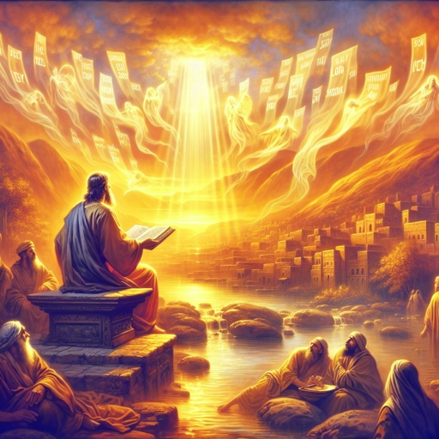
…was the WORD,
This idea of the logos as a cosmic, rational force influencing the universe would have been known to educated Greeks in the first century.

Slide 26
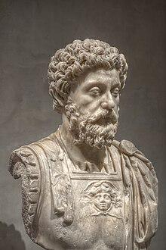
…was the WORD,
The Stoic philosophers (who were influential in the first century AD) also adopted and expanded the idea of logos.

Slide 27
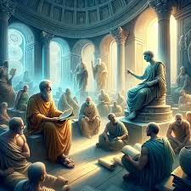
…was the WORD,
For them, the logos was the divine, rational principle that permeated the cosmos. They believed that logos

Slide 28
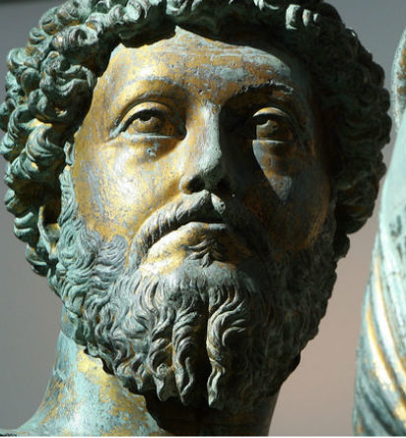
…was the WORD,
was the reason inherent in the natural order of the universe, and living in harmony with the logos meant aligning oneself with nature and rationality.

Slide 29
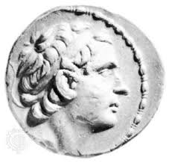
…was the WORD,
In Hellenistic Judaism, which was influenced by both Greek and Hebrew ideas, logos had theological significance.

Slide 30
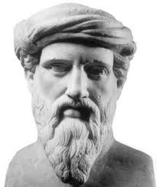
…was the WORD,
The Jewish philosopher Philo of Alexandria (c. 20 BC – AD 50) used logos to describe the intermediary between God and the world. For Philo, the logos was a divine agent,

Slide 31
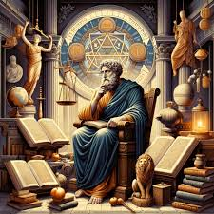
…was the WORD,
a bridge between the transcendent God and His creation. Philo's understanding of logos connected the Greek philosophical tradition with Jewish monotheism.

Slide 32
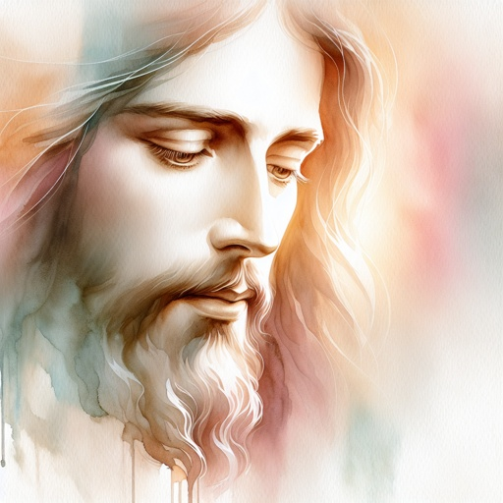
…was the WORD,
John’s logos draws on and yet is distinct from all of these understandings. Logos here is a designation for Christ, who came to reveal the character, mind, and will of the Father, even as speech is an expression of ideas.

Slide 33
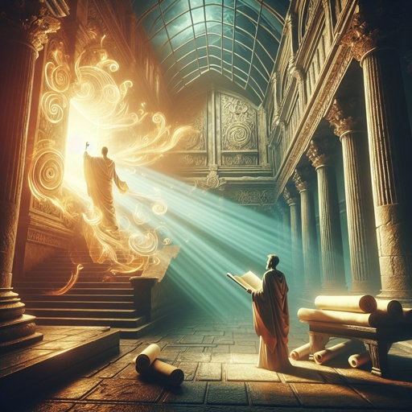
…was the WORD,
In the LXX the word logos is commonly used of both creative and communicative expressions of the divine mind and will. No doubt these Old Testament usages of logos were in the mind of John as he wrote.

Slide 34
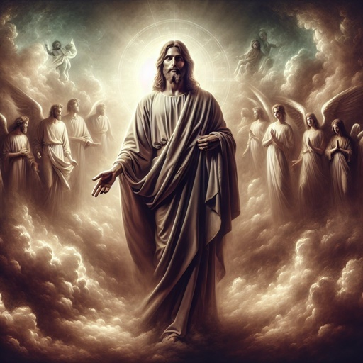
…was the WORD,
God has expressed His divine will and purpose through creation and through revelation; now He has done so through the incarnation, His supreme and perfect revelation.

Slide 35
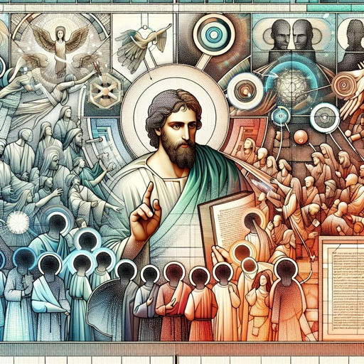
…was the WORD,
The word Logos thus epitomizes the dominate theme of the book of John. In v. 18 John states his reason for speaking of Christ as “the Word” –He came to “declare” the Father.

Slide 36

…was the WORD,
The term identifies Christ as the incarnate expression of the will of the Father that all men should be saved.

Slide 37
and the Word was with God,
John 1:1

Slide 38
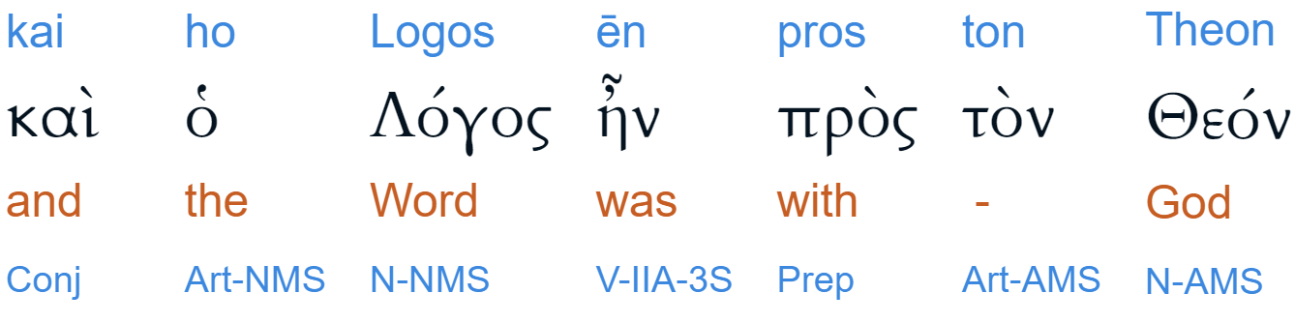
and the Word was with God,
John 1:1

Slide 39
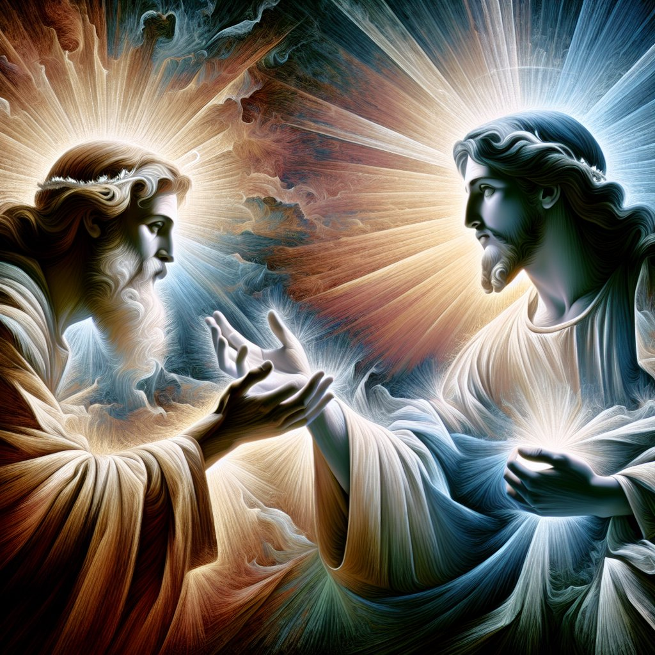
and the Word was with God,
In the Greek this is pros ton Theon. The word pros (with) denotes close association and fellowship.

Slide 40
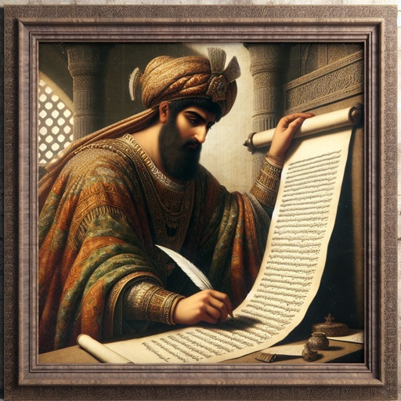
and the Word was with God,
Had John meant simply that in the beginning the Word was in proximity to God, he might have been expected to use either the word para, “beside” or the word meta, “with.”

Slide 41
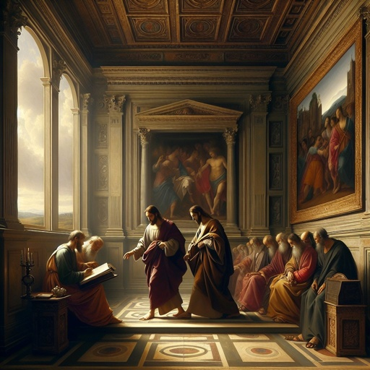
and the Word was with God,
But John intended more than either of those words would convey, as when he wrote, “we have an advocate with [pros] the Father” (1 John 2:1)

Slide 42
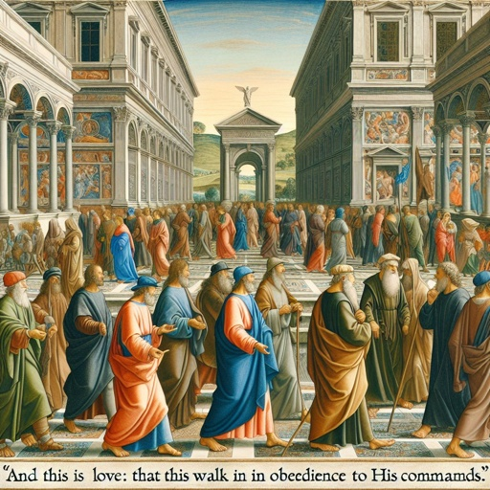
and the Word was with God,
Not in the sense that Jesus is simply in the Father’s presence, but that He is closely associated with the Father in the work of salvation.

Slide 43
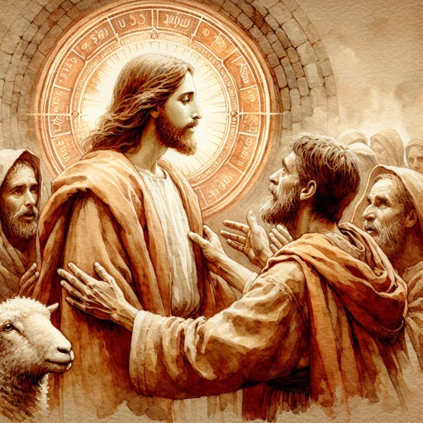
and the Word was with God,
Pros is used in the same sense in Heb. 4:13: ‘with whom we have to do,” that is, “with whom we have dealings.”

Slide 44
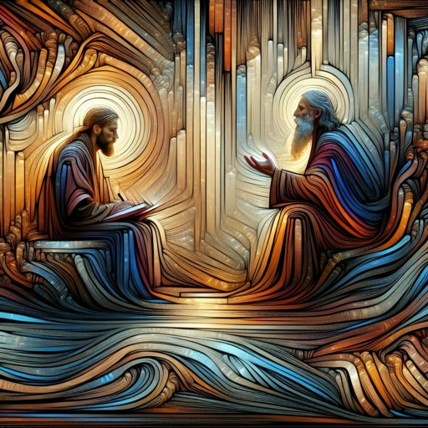
and the Word was with God,
The word here implies close personal fellowship in an enterprise of mutual interest and concern.

Slide 45
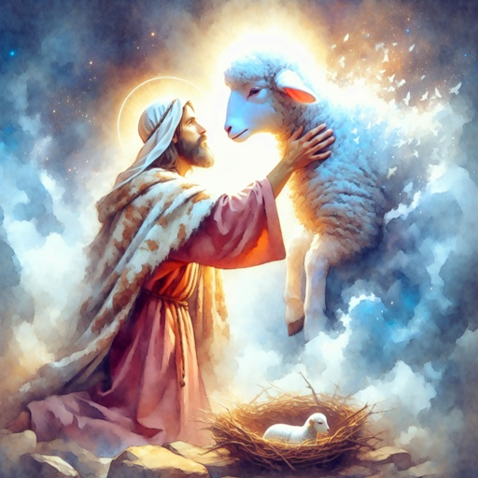
and the Word was with God,
The fact that the Word was “with God,” that is, with the Father, emphatically declares Him to be a being altogether distinct from the Father.

Slide 46
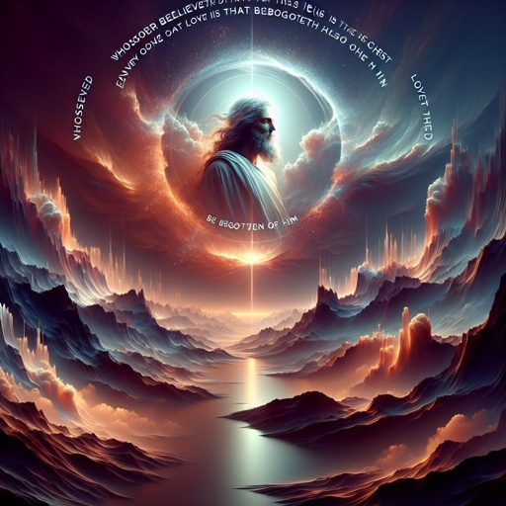
and the Word was with God,
As the context makes clear, the Word was associated with God in a unique and exclusive sense. The Word was “with God” in the eternity past, but He became “flesh” in order to be with “us.” (v. 14)

Slide 47
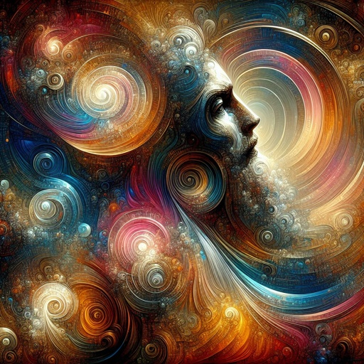
and the Word was with God,
He was Immanuel, “God with us.” It is impossible to understand the import of the incarnation except against the background of the eternal preexistence of Christ as God and as associated with God.

Slide 48
and the Word was God.
John 1:1

Slide 49
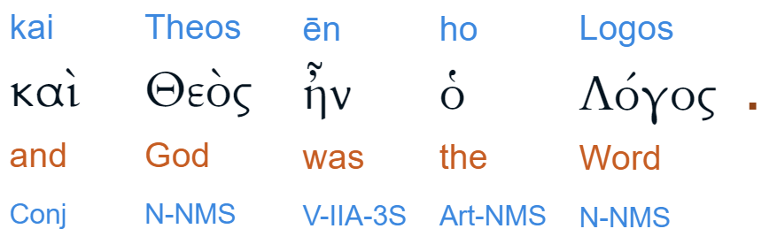
and the Word was God.
John 1:1

Slide 50
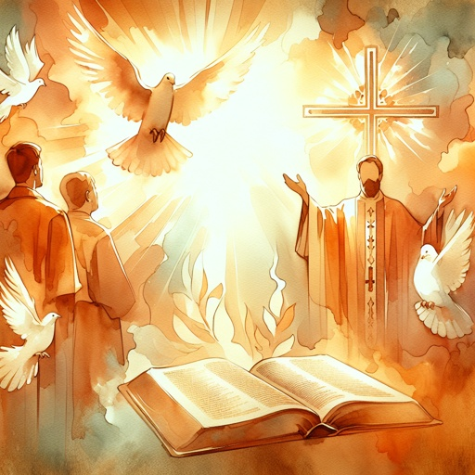
…and the Word was God.
The absence, in the Greek, of the definite article before the word “God” makes it impossible to render the statement, “God was the Word.”

Slide 51
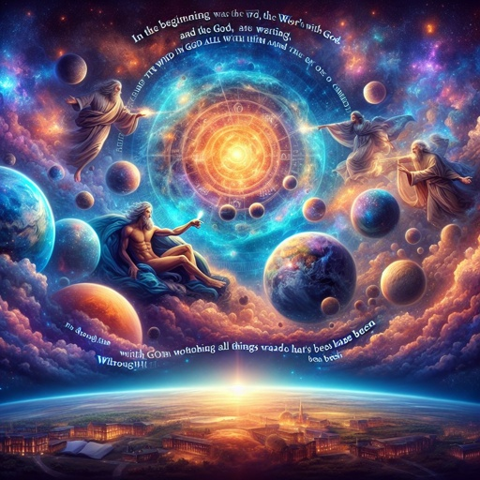
…and the Word was God.
Thus to render it would equate God with the Word and thus limit Deity exclusively to the Word. The two terms, “Word” and “God,” are not altogether interchangeable.

Slide 52
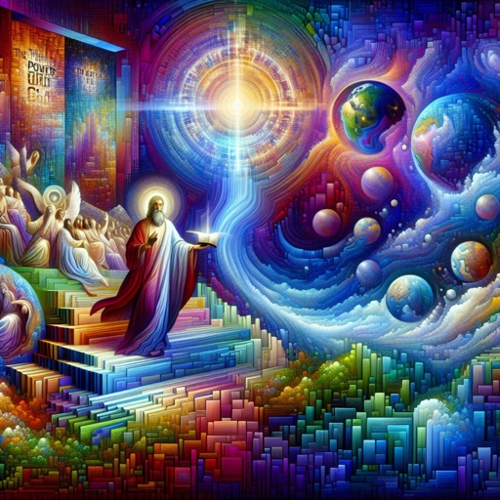
…and the Word was God.
It would be no more proper to say that “God was the Word” than to say that “love is God,” or, “flesh was made the Word.” Although here in v. 1 the word “God” lacks the definite article, it is still definite.

Slide 53
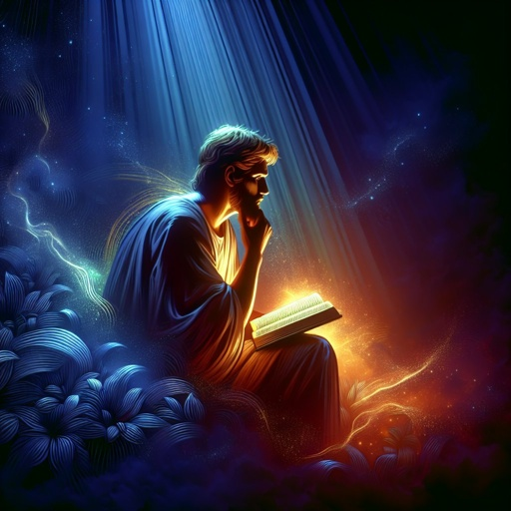
…and the Word was God.
The statement cannot be translated “the Word was a God,” as if the Word were one God among many other gods.

Slide 54
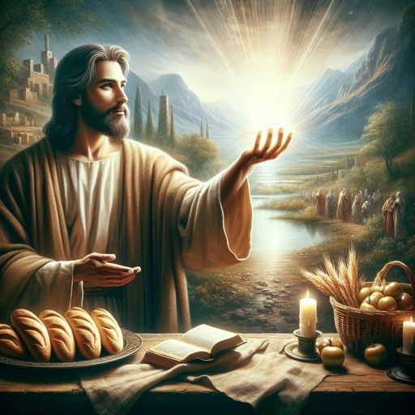
…and the Word was God.
In Greek the absence of the article often emphasizes quality expressed by, or inherent in, a word. Accordingly, John means that the Word partook of the essence of Deity,

Slide 55
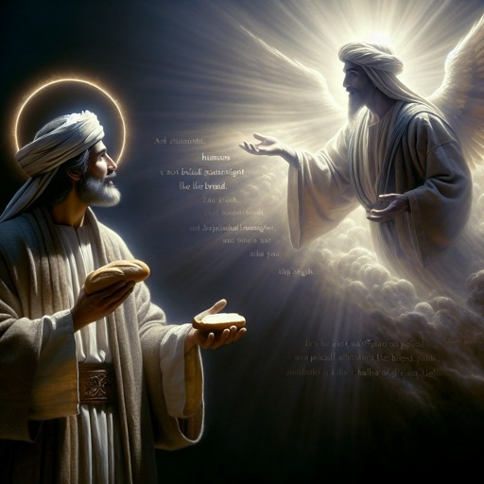
…and the Word was God.
that He was divine in the ultimate and absolute sense. Thus in one terse declaration John denies that the Word was either a God, one among many, or the God, as if He alone were God.

Slide 56

…and the Word was God.
In the prologue (vs. 1–18) John states the objective that guided him in writing the Gospel; namely, to present the man Jesus as God incarnate.

Slide 57
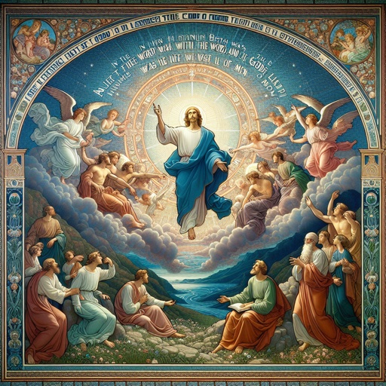
…and the Word was God.
From incident to incident and discourse to discourse he faithfully pursues this objective. In his conclusion he observes that his purpose in writing was

Slide 58
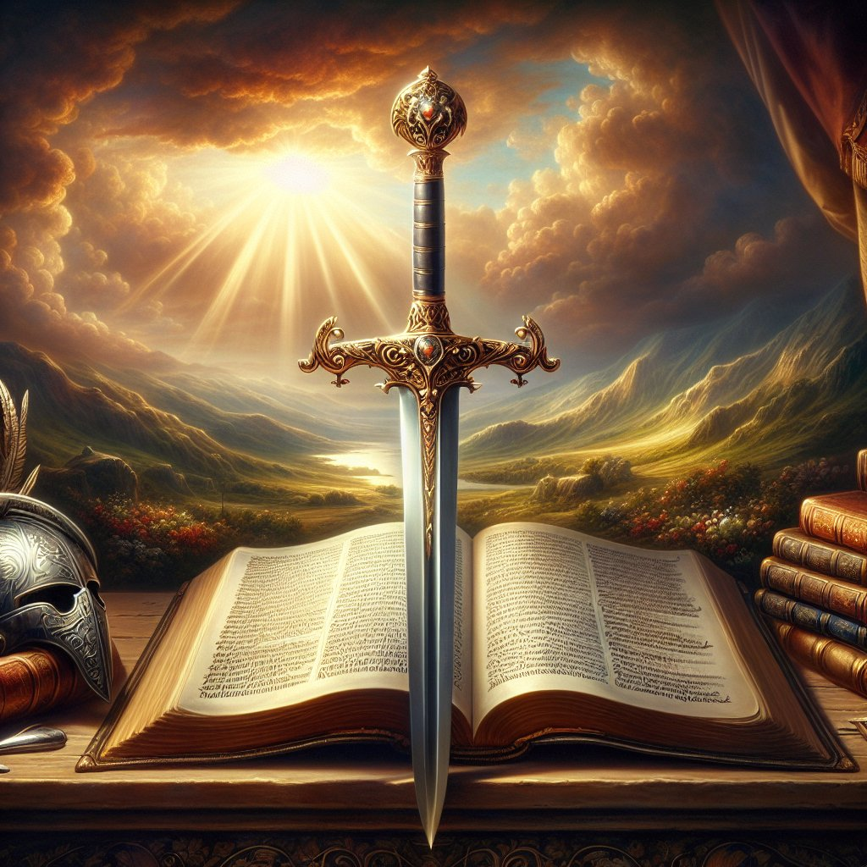
…and the Word was God.
to lead others to “believe that Jesus is the Christ, the Son of God,” and that believing they “might have life through his name” (John 20:30-31).

Slide 59
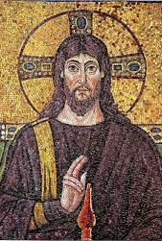
Christ and Controversies
The Christian faith finds its source, its center, and its certainty in the historical Christ of the NT. As set forth in John 1:1–3, 14) and consistently affirmed throughout the NT, Christ is God in the absolute and unqualified

Slide 60
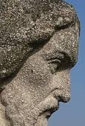
Christ and Controversies
sense of the word, and truly man in every respect, sin excepted. At the incarnation deity and humanity were inseparably united in the person Jesus Christ, the unique God-man.

Slide 61
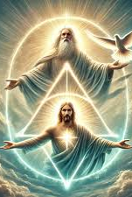
Christ and Controversies
But the Scriptures also declare that “the Lord our God is one Lord” (Deut. 6:4; Mark 12:29). The legacy of truth to which the Christian church fell heir thus included the paradox of a triune monotheism and the

Slide 62
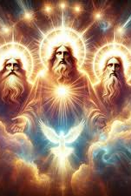
Christ and Controversies
mystery of an incarnate God, both of which concepts transcend finite understanding and defy ultimate analysis and definition. However, to ardent Christians of apostolic times, the

Slide 63

Christ and Controversies
dynamic fact of a crucified, risen, and living Lord, whom many of them had seen and heard (see John 1:14; 2 Peter 1:16; John 1:1–3), subordinated the related theological problems to a place of minor importance.

Slide 64
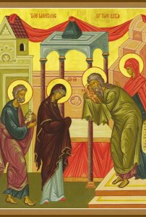
Christ and Controversies
But as, with the passing of that generation, the vision of a living Lord grew dim and pristine purity and devotion waned, men turned increasingly from the practical realities of the gospel to its intriguing theoretical aspects, under the illusion that by searching with the

Slide 65
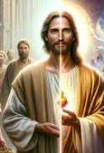
Christ and Controversies
intricate paraphernalia of philosophy they might, perhaps, find out God. Among the diverse heresies that arose to trouble the church none were more serious than those concerned with the nature and person of Christ.

Slide 66
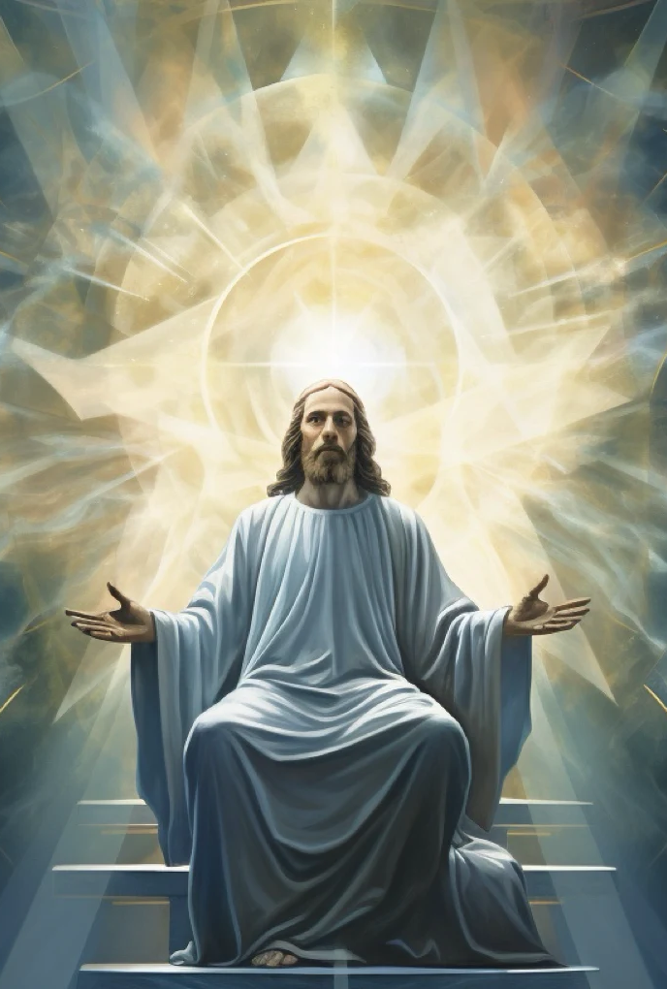
Christ and Controversies
Controversy over this problem rocked the church for centuries and was marked by a protracted succession of heresies, councils, and schisms.

Slide 67

Christ and Controversies
For any but students of church history a detailed study of this controversy may appear barren of interest and practical value. But today, no less than in apostolic times, the certainty of the Christian faith centers in the historic Christ of the NT.

Slide 68

Christ and Controversies
Also, in one guise or another, various ancient heresies either live on or have been revived. From a brief review of this controversy of earlier times modern Christians may learn to recognize, and to be vigilant against, the same errors that perplexed their devout brethren in ages past .

Slide 69
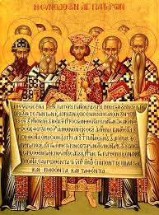
Christ and Controversies
The two principal phases of this protracted debate are generally known as the Trinitarian and Christological controversies. The first was concerned with the status of Christ as God, and the second with the incarnate relationship between His divine and human natures.

Slide 70
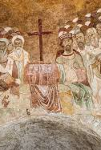
Christ and Controversies
The Trinitarian controversy centered in the battles of the church with Docetism, Monarchianism, and Arianism, from the 1st to the 4th century, and the Christological controversy in its struggles with Nestorianism, Monophysitism, and Monotheletism, from the 5th to the 7th century.

Slide 71

Christ and Controversies
The belief of the apostolic church concerning Jesus is well summed up in Peter’s affirmation that Jesus is “the Christ, the Son of the living God” (Matt. 16:16), and in the simple declaration of faith quoted by Paul, “Jesus is the Lord” (1 Cor. 12:3). The early Christians believed Him to be God in the highest sense of the word, and made this belief the cornerstone of their faith.

Slide 72

Christ and Controversies
“Flesh and blood” could not reveal or explain this truth; it must be accepted by faith (see Matt. 16:17). This implicit certainty of the primitive church concerning the Trinity and the divine-human nature of Christ was founded on the explicit teachings of Jesus and the apostles.

Slide 73

Christ and Controversies
It was not many years after Christ had ascended to heaven, however, that “grievous wolves” began to make havoc of the flock, and that within the church itself men arose speaking “perverse things” and drawing disciples away after them (see Acts 20:29, 30).

Slide 74

Trinitarian Controversy: Docetism
The first error concerning the nature and person of Christ is generally referred to as Docetism. This name comes from a Greek word meaning “to appear.” Docetism assumed various forms, but its basic idea was that Christ only appeared to have a body,

Slide 75

Trinitarian Controversy: Docetism
that He was a phantom and not a man at all. The Word became incarnate in appearance only. This heresy arose in apostolic times and persisted well on toward the close of the 2nd century.

Slide 76

Trinitarian Controversy: Docetism
Docetism was particularly characteristic of such groups as the Ebionites and the Gnostics. The former were Jewish Christians who adhered strictly to the rites and practices of Judaism. The latter were primarily Gentile Christians.

Slide 77

Trinitarian Controversy: Docetism
Gnosticism was little more than a blend of various pagan philosophies masquerading under the guise of Christian terminology.

Slide 78

Trinitarian Controversy: Docetism
An early and possibly authentic tradition identifies Simon Magus (see Acts 8:9–24) as the first proponent of error concerning the nature and person of Christ, and as the first Christian Gnostic.
1st Century AD

Slide 79

Trinitarian Controversy: Docetism
A few years later a Christian by the name of Cerinthus arose in Alexandria, a man who is classed by some as an Ebionite and by others as a Gnostic. He denied that Christ had come in the flesh,
1st Century AD

Slide 80

Trinitarian Controversy: Docetism
maintaining that His supposed incarnation was apparent and not real. The Ebionites were not Gnostics but held similar views concerning the humanity of Christ. They regarded Christ as
1st Century AD

Slide 81

Trinitarian Controversy: Docetism
only the literal son of Joseph, but selected by God as the Messiah because He distinguished Himself for piety and observance of the law, and was adopted as the Son of God at His baptism.
1st Century AD

Slide 82

Trinitarian Controversy: Docetism
One group of Ebionites, the Elkesaites, taught that Christ had been literally “begotten” of the Father in ages past, and was thus inferior to Him. In contrast with the Ebionites, who looked upon Christ as essentially
1st – 4th Centuries AD

Slide 83

Trinitarian Controversy: Docetism
a superior type of human being, the Gnostics, generally speaking, denied that He was a human being at all. They conceived of Christ as a phantom, or “aeon,” that temporarily took possession of Jesus, an ordinary human being.
1st – 2nd Centuries AD

Slide 84

Trinitarian Controversy: Docetism
Divinity was not truly incarnate. Concerning the tremendous impact of Gnosticism upon Christianity the church historian Latourette suggests the possibility that “for a time the majority of those who regarded
1st – 2nd Centuries AD

Slide 85

Trinitarian Controversy: Docetism
themselves as Christians adhered to one or another of its many forms” (K. S. Latourette, A History of Christianity, p. 123). Arising gradually in apostolic times, Gnosticism reached the apex of its influence upon the church during the 2d century. Recognizing the grave threat posed by
1st – 2nd Centuries AD

Slide 86

Trinitarian Controversy: Docetism
Gnosticism, the church fought back heroically. Writing during the latter half of the 2d century, Irenaeus remarks that John wrote his Gospel with the specific purpose of refuting the Docetic views of Cerinthus (Irenaeus Against Heresies xi. 1, in Ante-Nicene Fathers, Vol. 1, p. 426; see John 1:1–3, 14; 20:30, 31). In the epistles John even more clearly warns against the Docetic heresy, whose advocates he brands as “anti-christ” (1 John 2:18–26; John 4:1–3, 9, 14; 2 John 7, 10).
1st – 2nd Centuries AD

Slide 87

Trinitarian Controversy: Docetism
During his first imprisonment in Rome (c. A.D. 62), Paul cautioned the believers in Colossae against Docetic error (Col. 2:4, 8, 9, 18), and about the same time Peter voiced an even stronger warning (2 Peter 2:1–3). Jude (v. 4) refers to the Docetic heresy. The “Nicolaitanes” of Rev. 2:6 were Gnostics, though not necessarily Docetists (Irenaeus Against Heresies xi. 1, in Ante-Nicene Fathers, vol. 1, p. 426).
1st – 2nd Centuries AD

Slide 88

Trinitarian Controversy: Docetism
During the first half of the 2d century various Gnostic teachers arose to plague the church with their noxious heresies. Prominent among these were Basilides and Valentinus, both of Alexandria. But perhaps the most influential—and successful— proponent of Docetic ideas was Marcion, during the latter half of the same century. He was by no means a
1st – 2nd Centuries AD

Slide 89

Trinitarian Controversy: Docetism
Gnostic, but his views about Christ closely resembled those of the Gnostics. He held that the birth, physical life, and death of Jesus were not real, but merely gave the appearance of reality.
Against the gross errors of Docetism the church struggled courageously. During the latter half of the 2d century Irenaeus came boldly forward as the great
1st – 2nd Centuries AD

Slide 90

Trinitarian Controversy: Monarchianism
champion of orthodoxy against heresy. His polemical work Against Heresies, specifically the Gnostic heresy, has survived to the present day. Irenaeus emphasized the unity of God. Monarchianism. As the name indicates, Monarchianism stressed the unity of the Godhead. (A “monarch” is literally a “sole ruler.”) It was, in effect, a reaction against the many gods of
1st – 2nd Centuries AD

Slide 91

Trinitarian Controversy: Monarchianism
the Gnostics and the two gods of Marcion—the God of the OT, whom he considered an evil God, and Christ, a God of love. As reactionary movements so often do, it went to the opposite extreme, and as a result became a heresy the church later found it necessary to condemn. The trend of which Monarchianism was characteristic may largely be credited with purging the church
1st – 2nd Centuries AD

Slide 92

Trinitarian Controversy: Monarchianism
of Gnostic teachings, but the cure caused almost as much havoc as the malady it was supposed to remedy. The struggle with Monarchianism began toward the close of the 2d century and continued well into the 3d. There were two types of Monarchians, the Dynamists (from a Greek work meaning “power”), who taught that a divine power animated the human body of
2nd – 3rd Centuries AD

Slide 93

Trinitarian Controversy: Monarchianism
Jesus, who supposedly had no proper deity of His own and lacked a true human soul, and the Modalists, who conceived of one God who had revealed Himself in different ways.
In order to maintain the unity of the Godhead the Dynamists utterly denied the deity of Christ, whom they considered a mere man chosen of God to be the Messiah and raised to a level of deity. According to Adoptionism, one
2nd – 3rd Centuries AD

Slide 94

Trinitarian Controversy: Monarchianism
variation of this theory, the man Jesus attained to perfection and was adopted as the Son of God, at His baptism. The Modalists taught that one God had revealed Himself in different ways. Denying any distinction in personality, they abandoned belief in the triune nature of the Godhead altogether. They accepted the true divinity of both Father and Son, but hastened to explain that the two
2nd – 3rd Centuries AD

Slide 95

Trinitarian Controversy: Monarchianism
were only different designations for the same divine being. This view is sometimes called Patripassianism, because, presumably, the Father became the Son at the incarnation, and subsequently suffered and died as the Christ. Similarly, at the resurrection, the Son became the Holy Spirit. From the most famous exponent of the theory, Sabellius, this view is also called
2nd – 3rd Centuries AD

Slide 96

Trinitarian Controversy: Monarchianism
Sabellianism. The Sabellians held that the names of the Trinity were merely designations by which the same divine person performed various cosmic functions. Thus prior to the incarnation this divine being was the Father; at the incarnation the Father became the Son; and at the resurrection the Son became the Holy Spirit. Early in the 3d century Tertullian
2nd – 3rd Centuries AD

Slide 97

Trinitarian Controversy: Monarchianism
refuted Modalistic Monarchianism, stressing both the personality of the Son of God and the unity of the Godhead. However, he proposed that Christ was a subordinate order of God—a theory known as Subordinationism. About the middle of the 3d century Origen advanced the theory of eternal generation, according to which
2nd – 3rd Centuries AD

Slide 98

Trinitarian Controversy: Monarchianism
the Father alone is God in the highest sense. The Son is coeternal with the Father, but “God” only in a derived sense. Origen believed that Christ’s soul— like all human souls, as he mistakenly supposed—pre-existed, but differed from all others in being pure and unfallen. The Logos, or divine Word, grew into indissoluble union with the
3rd Century AD

Slide 99

Trinitarian Controversy: Monarchianism
human soul of Jesus. Distinguishing between theos, God, and ho theos, the God, in John 1:1, Origen concluded that the Son is not God in the primary and absolute sense, but “God” only by virtue of the communication of a secondary grade of divinity which might be termed theos, but not ho theos. Christ would thus be midway
3rd Century AD

Slide 100

Trinitarian Controversy: Arianism
between things created and uncreated. Origen may be called the father of Arianism.
Early in the 4th century Arius, a presbyter of the church in Alexandria, adopted Origen’s theory of the Logos, except that he denied any substance intermediate between God and created beings. From this he deduced that the Son is not divine
4th Century AD

Slide 101

Trinitarian Controversy: Arianism
in any sense of the word, but strictly a creature, though the very highest and first of all, and that therefore “there was [a time] when He was not.” He taught that there is only one being— the Father—to whom timeless existence can be attributed, that the Father created the Son out of nothing, and that prior to His generation by an act of the
4th Century AD

Slide 102

Trinitarian Controversy: Arianism
Father’s will the Son did not exist. To Arius, Christ was neither truly human, for He was without a human soul, nor yet truly divine, for He was without the essence and attributes of God. He was simply the most exalted of all created beings. The human being Jesus was chosen, by virtue of God’s foreknowledge of His triumph, to be the Christ. At the
4th Century AD

Slide 103

Trinitarian Controversy: Arianism
First Council of Nicaea, convened in A.D. 325 to settle the Arian controversy, Athanasius stepped forward as “the father of orthodoxy,” maintaining that Jesus Christ always was, and that He came, not from the previously nonexistent, but from the very same essence as the Father. Applying the term homoousios, “one substance,” to Christ, the council affirmed its belief that
4th Century AD

Slide 104

Trinitarian Controversy: Arianism
He is of one and the same essence as the Father. Homoousios could not be understood otherwise. The council anathematized both Arianism and Sabellianism as the two principal deviations from exact truth, and declared that it was not denying the unity of the Godhead when it asserted the trinity, nor denying the trinity when
4th Century AD

Slide 105

Trinitarian Controversy: Arianism
it asserted the unity. Thus the Nicene Creed states that the Son is “begotten of the Father [… the essence of the Father, God of God], Light of Light, very God of very God, begotten, not made, being of one substance (ὁμοούςιον) with the Father” (cited in Philip Schaff, The Creeds of Christendom, vol. 1, p. 29). This creed became the crucial test of Trinitarian orthodoxy. The Arians rejected
4th Century AD

Slide 106

Trinitarian Controversy: Arianism
the decision of the council and went into schism, and for centuries Arianism proved to be the most formidable foe of the Roman Catholic Church (see on Dan. 7:8). Following the First Council of Nicaea a group sometimes called semiArians also troubled the church. Their key word was homoiousios, by which they described the Son as being of “like substance” with the
4th Century AD

Slide 107

Trinitarian Controversy: Arianism
Father, in contrast with the homoousios (“same substance”) of the Nicene Creed. Prominent among opponents of orthodoxy following the Council of Nicaea were Apollinaris and Marcellus. Both affirmed the true unity of the divine and the human in Christ but denied His true humanity, asserting that the divine will made of the human nature of Jesus a passive instrument. These
4th Century AD

Slide 108

Trinitarian Controversy: Arianism
various problems led to another council in the year 381, at Constantinople. This council reaffirmed the Nicene Creed, clarified its meaning, and declared the presence of two real natures in Christ. After the Council of Constantinople the attention of the church turned to the so-called Christological aspect of the problem of the nature and person of Christ.
4th Century AD

Slide 109

Christological Controversy: Nestorianism
Attempts were made to define the nature of the divine and of the human elements in Christ, and to state the relationship between these two. How could two personal natures exist together in one person? This phase of the controversy centered in two opposing schools of thought, one in Alexandria and the other in Antioch, in Syria. Both acknowledged the true unity of
5th Century AD

Slide 110
Christological Controversy: Nestorianism
divinity and humanity in the one person, Jesus Christ, but the Alexandrian school emphasized the unity of the two natures and stressed the importance of deity, whereas the Antiochian school emphasized the distinction between the two natures and stressed the importance of the human aspect. Partisans of Antioch held that divinity and
4th Century AD

Slide 111

Christological Controversy: Nestorianism
humanity had entered into a relation of constant coexistence and cooperation without actually merging. They separated the two natures in the one person, declaring that there was not a complete union but only permanent association. They made a sharp distinction between Christ as the Son of God and Christ as the Son of man, and gave the human nature more
4th Century AD

Slide 112

Christological Controversy: Nestorianism
distinct recognition. They conceived of the unity of the two natures as accomplished through the unity of the respective wills. They preserved the reality and completeness of Christ’s human nature, but endangered the unity of the person. It was an imperfect, incomplete, loose, mechanical union, in which the two natures were not truly united in a single selfconscious person. The
4th Century AD

Slide 113

Christological Controversy: Nestorianism
Alexandrians, on the other hand, conceived of a miraculous and complete commingling of the two natures, the human being fused into one with the divine and made subordinate to it. God thus entered humanity, and by means of this union of Godhood and manhood it became possible for Christ to lead mankind back to God. The collision between these two schools of thought reached its
4th Century AD

Slide 114

Christological Controversy: Nestorianism
climax in the Nestorian controversy early in the 5th century. Nestorius, of Antioch, conceded true deity and true humanity, but denied their union in a single self-conscious person. The Nestorian Christ is really two persons enjoying a moral and sympathetic union, neither however, being decisively affected by the other. Deity is not humbled; humanity is not exalted.
4th Century AD

Slide 115

Christological Controversy: Nestorianism
There is God and there is man; but there is no God-man. The third ecumenical church council was called at Ephesus, in 431, for the purpose of settling this contest between the schools of Antioch and Alexandria. The council condemned Nestorius and his teachings, but did not consider it necessary to draw up a new creed to replace the Nicene Creed. Nothing was really settled
4th Century AD

Slide 116

Christological Controversy: Nestorianism
or accomplished, except to widen the rift, and the ensuing controversy took on such proportions that all other doctrinal problems were laid aside. Following the Council at Ephesus still another theory, known as Monophysitism, or Eutychianism, arose and took the stage to set forth a conception of Christ precisely opposite to that of Nestorius.
4th Century AD

Slide 117

Christological Controversy: Monophysitism
Eutyches, its leading exponent, contended that the original human nature of Jesus was transmuted into the divine nature at the incarnation, with the result that the human Jesus and divine Christ became one person and one nature. He asserted the unity of self-consciousness but so merged the two natures that, for practical purposes, they lost their individual identity.
Convened in 451 to discuss Nestorianism and Monophysitism, the Council of
Chalcedon decided against both. Both Nestorius and Eutyches rejected the decision of the
council and founded independent sects of Christianity, as Arius had done more than a
century earlier.
The Council of Chalcedon affirmed the perfect divinity and the perfect humanity of
Christ, declaring Him to be of one substance with the Father as to His divine nature and
of one substance with us as to His human nature, except for sin. The identity of each
nature was preserved and the two were declared to be distinct, unmingled, immutable,
indivisible, inseparable. Divinity, not humanity, was recognized as the basis of Christ’s
personality. Because the one person is a union of two natures, the suffering of the Godman was truly infinite; He suffered in His human nature and not in His divine nature, but
the passion was infinite because the person is infinite. What later came to be known as
the Chalcedon Symbol reads in part:
“We, then, following the holy Fathers, all with one consent, teach men to confess one
and the same Son, our Lord Jesus Christ, the same perfect in Godhead and also perfect in
manhood; truly God and truly man, of a reasonable [rational] soul and body;
consubstantial [of one substance] with the Father according to the Godhead, and
consubstantial with us according to the Manhood; in all things like unto us, without sin;
begotten before all ages of the Father according to the Godhead, and in these latter days,
for us and for our salvation, born of the Virgin Mary, the Mother of God, according to the
Manhood; one and the same Christ, Son, Lord, Only-begotten, to the acknowledged in
two natures, inconfusedly, unchangeably, indivisibly, inseparably; the distinction of
natures being by no means taken away by the union, but rather the property of each
nature being preserved, and concurring in one Person and one Subsistence” (Philip
Schaff, The Creeds of Christendom, vol. 2, p. 62).
The result of the Council of Chalcedon was to perpetuate and intensify schism in the
East. Finally the emperor Justinian, convinced that the security of the empire required a
settlement of the problem, permanently closed the schools at Antioch and Alexandria, the
two centers of controversy. At a second Council of Constantinople, in 553, the church
decided upon the forcible suppression of Monophysitism, which went into permanent
schism and persists to this day in Christian sects such as the Jacobites, the Copts, and the
Abyssinians. Reaffirming the Symbol of Chalcedon, the church achieved a definitive
distinction between orthodoxy and heterodoxy.
Monotheletism. It is true that one question remained unsettled: Are the two natures,
the divine and the human, actuated by one will controlling both natures, or by two wills?
The Monothelites considered the divine will dominant, and the human will submerged in
it. At the third Council of Constantinople, in 680, the church decided that the will is a
matter of the natures rather than of the one person, and pronounced in favor of two wills
in one volitional person. This completed the orthodox definition of the nature and person
of Christ for the Western Church, and brought the protracted Trinitarian and
Christological controversies formally to a close. About the year 730 John of Damascus
recapitulated these doctrines for the Eastern Church. For both East and West the
decisions of the councils became a matter of dogma.
In Reformation Times. The Reformation found both Roman and Protestant branches
of Christianity in fundamental agreement on the Trinity and the nature of Christ. The
Nicene Creed and the Symbol of Chalcedon proved generally acceptable to both. Luther
taught a mutual interchange of characteristics between the two natures, so that what was
characteristic of each became common to both. Everything human in Christ was
appropriated by the divine nature, and humanity received what belonged to the divine
nature. The Reformed churches emphasized the fellowship of the divine and the human in
Christ.
Two minor Reformation groups differed from the Nicene position. The first of these
was the Socinians, who revived the basic Monarchian idea that a divine Trinity is
inconceivable. Modern Unitarianism perpetuates this concept. The second group was the
Arminians, who took a view similar, in some respects, to that of certain earlier groups,
that the Son is subordinate
4th Century AD

Slide 118

Christological Controversy: Monophysitism
Convened in 451 to discuss Nestorianism and Monophysitism, the Council of Chalcedon decided against both. Both Nestorius and Eutyches rejected the decision of the council and founded independent sects of Christianity, as Arius had done more than a century earlier. The Council of Chalcedon affirmed the perfect divinity and the perfect humanity
5th Century AD

Slide 119

Christological Controversy: Monophysitism
was recognized as the basis of Christ’s personality. Because the one person is a union of two natures, the suffering of the Godman was truly infinite; He suffered in His human nature and not in His divine nature, but the passion was infinite because the person is infinite. What later came to be known as the Chalcedon Symbol reads in part:
5th Century AD

Slide 120

Christological Controversy: Monophysitism
“We, then, following the holy Fathers, all with one consent, teach men to confess one and the same Son, our Lord Jesus Christ, the same perfect in Godhead and also perfect in manhood; truly God and truly man, of a reasonable [rational] soul and body; consubstantial [of one substance] with the Father according to the Godhead, and
5th Century AD

Slide 121

Christological Controversy: Monophysitism
consubstantial with us according to the Manhood; in all things like unto us, without sin; begotten before all ages of the Father according to the Godhead, and in these latter days, for us and for our salvation, born of the Virgin Mary, the Mother of God, according to the Manhood; one and the same Christ, Son, Lord, Only-begotten, to the acknowledged in two natures,
5th Century AD

Slide 122

Christological Controversy: Monophysitism
inconfusedly, unchangeably, indivisibly, inseparably; the distinction of natures being by no means taken away by the union, but rather the property of each nature being preserved, and concurring in one Person and one Subsistence” (Philip Schaff, The Creeds of Christendom, vol. 2, p. 62). The result of the Council of Chalcedon was to perpetuate and intensify schism in
5th Century AD

Slide 123

Christological Controversy: Monophysitism
the East. Finally the emperor Justinian, convinced that the security of the empire required a settlement of the problem, permanently closed the schools at Antioch and Alexandria, the two centers of controversy. At a second Council of Constantinople, in 553, the church decided upon the forcible suppression of Monophysitism, which went into permanent
5th Century AD

Slide 124

Christological Controversy: Monophysitism
schism and persists to this day in Christian sects such as the Jacobites, the Copts, and the Abyssinians. Reaffirming the Symbol of Chalcedon, the church achieved a definitive distinction between orthodoxy and heterodoxy.
It is true that one question remained unsettled: Are the two natures, the divine and the
5th Century AD

Slide 125

Christological Controversy: Monotheletism
human, actuated by one will controlling both natures, or by two wills?
The Monothelites considered the divine will dominant, and the human will submerged in it. At the third Council of Constantinople, in 680, the church decided that the will is a matter of the natures rather than of the one person, and pronounced in favor of two wills
6th Century AD

Slide 126

Christological Controversy: Monotheletism
in one volitional person. This completed the orthodox definition of the nature and person of Christ for the Western Church, and brought the protracted Trinitarian and Christological controversies formally to a close. About the year 730 John of Damascus recapitulated these doctrines for the Eastern Church. For both East and West the decisions of the councils became a matter of dogma.
7th Century AD

Slide 127

Christological Controversy: The Reformation
The Reformation found both Roman and Protestant branches of Christianity in fundamental agreement on the Trinity and the nature of Christ. The Nicene Creed and the Symbol of Chalcedon proved generally acceptable to both. Luther taught a mutual interchange of characteristics between the two natures, so that what was characteristic of each became
7th Century AD

Slide 128

Christological Controversy: The Reformation
common to both. Everything human in Christ was appropriated by the divine nature, and humanity received what belonged to the divine nature. The Reformed churches emphasized the fellowship of the divine and the human in Christ. Two minor Reformation groups differed from the Nicene position. The first of these was the Socinians, who
7th Century AD

Slide 129

Christological Controversy: The Reformation
revived the basic Monarchian idea that a divine Trinity is inconceivable. Modern Unitarianism perpetuates this concept. The second group was the Arminians, who took a view similar, in some respects, to that of certain earlier groups, that the Son is subordinate to the Father. This view is similarly reflected by various Christian sects today.
7th Century AD

Slide 130
The writers of the commentaries and I frankly confess that there are great mysteries in the Scriptures which transcend the limits of finite understanding and thus defy precise statement in human language. The union of the divine and the human in Christ is one such mystery. In dealing with theological questions of this kind Seventh-day Adventists have ever sought to eschew speculation and finespun philosophizing, lest they darken counsel with words (see 8T 279). If the inspired writers of the Bible have not made clear every detail of the divine mysteries, why should uninspired writers attempt to do so? However, Inspiration has provided sufficient information to enable us to understand in part the mystery of the plan of salvation. Seventh-day Adventists believe in:

Slide 131

1. The Godhead. The Godhead, or Trinity, consists of three persons—the eternal Father, the Lord Jesus Christ, Son of the eternal Father, and the Holy Spirit (see Matt. 28:19; John 1:1, 2; 6:27; 14:16, 17, 26; Acts 5:3, 4; Eph. 4:4–6; Heb. 1:1–3, 8; see on John 1:1–3, 14). “There are three living persons of the heavenly trio … the Father, the Son, and the Holy Spirit” (Ev 615). Christ and the Father are “one in nature, in character, in purpose” (PP 34), but “not in person” (8T 269; cf. 9T 68). The Holy Spirit “is as much a person as God is a person” (Ev 616). See EGW Supplementary Material on Rom. 1:20–25.

Slide 132

2. The Deity and Pre-existence of Christ. Christ is God in the supreme and unqualified sense of the term—in nature, in wisdom, in authority, and in power (see Isa. 9:6; Micah 5:2; John 1:1–3; 8:58; 14:8–11; Col. 1:15–17; 2:9; Heb. 1:8; see on Micah 5:2; Matt. 1:1, 23; Luke 1:35; John 1:1–3; 16:28; Phil. 2:6–8; Col. 2:9).

Slide 133
3. The Humanity of Christ. The Lord Jesus Christ was a true and complete human being, like other men in all respects except that He “knew no sin” (2 Cor. 5:21; see Luke 24:39; John 1:14; Rom. 1:3, 4; 5:15; Gal. 4:4; Phil. 2:7; 1 Tim. 2:5; Heb. 2:14, 17; 1 John 1:1; 4:2; 2 John 7; see on Matt. 1:23; John 1:14; Phil. 2:6–8). “Christ was a real man” (EGW YI Oct. 13, 1898), “fully human” (EGW ST June 17, 1897), “a partaker of our nature” (EGW RH Feb. 18, 1890). “He came as a helpless babe, bearing the humanity we bear” (EGW MS 21, 1895), and “as a member of the human family He was mortal” (EGW RH Sept. 4, 1900). “He prayed for His disciples and for Himself, thus identifying Himself with our needs, our weaknesses, and our failings” (2T 508; cf. MH 422). See EGW Supplementary Material on John 1:1–3, 14; Col. 1:26, 27; Heb. 2:14–18.

Slide 134
4. The Incarnation of Christ. The incarnation was a true, complete, and indissoluble union of the divine and human natures in the one person, Jesus Christ, each nature, however, being preserved intact and distinct from the other (see Matt. 1:20; Luke 1:35; John 1:14; Phil. 2:5–8; 1 Tim. 3:16; 1 John 4:2, 3; see on Matt. 1:18; John 1:14; 16:28; Phil. 2:6–8). “Christ was a real man. … Yet He was God in the flesh” (EGW YI Oct. 13, 1898). “His divinity was veiled with humanity,—the invisible glory in the visible human form” (DA 23). “He has a two-fold nature, at once human and divine. He is both God and man” (EGW MS 76, 1903). “Was the human nature of the Son of Mary changed into the divine nature of the Son of God? No; the two natures were mysteriously blended in one person—the Man Christ Jesus” (EGW letter 280, 1904). “The human did not take the place of the divine, nor the divine of the human” (EGW ST May 10, 1899). “Divinity was not degraded to humanity; divinity held its place” (EGW RH Feb. 18, 1890). “He exhibited a perfect humanity, combined with deity; … preserving each nature distinct” (EGW GCB 4th quarter, 1899, p. 102). “The humanity of Christ could not be separated from His divinity” (EGW MS 106, 1897). See EGW Supplementary Material on John 1:1–3, 14; Eph. 3:8; Phil. 2:6–8; Col. 2:9.

Slide 135
5. The Subordination of Christ. Voluntarily assuming the limitations of human nature at the incarnation, the Lord Jesus Christ thereby subordinated Himself to the Father for the duration of His earthly ministry (see Ps. 40:8; Matt. 26:39; John 3:16; 4:34; 5:19, 30; 12:49; 14:10; 17:4, 8; 2 Cor. 8:9; Phil. 2:7, 8; Heb. 2:9; see on Luke 1:35; 2:49; John 3:16; 4:34; Phil. 2:7, 8). “Laying aside His royal robe and kingly crown” (9T 68), the The Son of God “chose to give back the scepter into the Father’s hands, and to step down from the throne of the universe” (DA 22, 23). “He voluntarily assumed human nature. It was His own act, and by His own consent” (EGW RH Sept. 4, 1900). “Jesus condescended to humble Himself, to take human nature” (EGW ST Jan. 20, 1890; cf. 5T 702). “He humbled Himself, and took mortality upon Him” (EGW RH Sept. 4, 1900). “The Son of God was surrendered to the Father’s will, and dependent upon His power. So utterly was Christ emptied of self that He made no plans for Himself. He accepted God’s plans for Him, and day by day the Father unfolded His plans” (DA 208; cf. 664). “While bearing human nature, He was dependent upon the Omnipotent for His life. In His humanity, He laid hold of the divinity of God” (EGW ST June 17, 1897). See EGW Supplementary Material on Luke 1:35.

Slide 136
6. The Sinless Perfection of Christ. Though susceptible to temptation and “in all points tempted like as we are,” Jesus was nevertheless altogether “without sin” (see Matt. 4:1–11; Rom. 8:3, 4; 2 Cor. 5:21; Heb. 2:10; 4:15; 1 Peter 2:21, 22; 1 John 3:5; see on Matt. 4:1–11; 26:38, 41; Luke 2:40, 52; Heb. 2:17; 4:15). Our Saviour “assumed the liabilities of human nature, to be proved and tried” (EGW ST Aug. 2, 1905; cf. DA 49, 117, 131). “Like every child of Adam He accepted the results of the working of the great law of heredity” (DA 49). “He could have sinned; … but not for one moment was there in Him an evil propensity” (EGW letter 8, 1895, see p. 1128). He took “the nature but not the sinfulness of man” (EGW ST May 29, 1901). “He vanquished Satan in the same nature over which in Eden Satan obtained the victory” (EGW YI April 25, 1901). “Jesus revealed no qualities, and exercised no powers, that men may not have through faith in Him. His perfect humanity is that which all His followers may possess” (DA 664; cf. 24). “In His human nature He maintained the purity of His divine character” (ML 323). “No trace of sin marred the image of God within Him” (DA 71; cf. 123). See EGW Supplementary Material on Matt. 4:1–11; Luke 2:40, 52; Col. 2:9, 10; Heb. 2:14–18; 4:15.

Slide 137
7. The Vicarious Death of Christ. The sacrifice of Christ provided full and complete atonement for the sins of the world (see Isa. 53:4–6; John 3:14–17; 1 Cor. 15:3; Heb. 9:14; 1 Peter 3:18; 4:1; 1 John 2:2; see on Isa. 53:4; Matt. 16:13). “He was condemned for our sins, in which He had no share, that we might be justified by His righteousness, in which we had no share. He suffered the death which was ours, that we might receive the life which was His” (DA 25). “In the Garden of Gethsemane, Christ suffered in man’s stead, and the human nature of the Son of God staggered under the terrible horror of the guilt of sin” (EGW MS 35, 1895). “Human nature would then and there have died under the horror of the sense of sin, had not an angel from heaven strengthened Him to bear the agony” (EGW MS 35, 1895). “Christ’s sacrifice in behalf of man was full and complete. The condition of the atonement had been fulfilled. The work for which He had come to this world had been accomplished” (AA 29; cf. 5T 575). See EGW Supplementary Material on Matt. 26:36–46; 27:50; Col. 2:9; 1 Tim. 2:5.

Slide 138

8. The Resurrection of Christ. In His divinity Christ had power not only to lay down His life but to take it up again, when summoned forth from the grave by His Father (see John 10:18; Acts 13:32, 33; Rom. 1:3, 4; 1 Cor. 15:3–22; Heb. 13:20; 1 Peter 1:3; see Additional Note on Matt. 28). “When the voice of the mighty angel was heard at Christ’s tomb, saying, Thy Father calls Thee, the Saviour came forth from the grave by the life that was in Himself. … In His divinity, Christ possessed the power to break the bonds of death” (DA 785; cf. 780). See EGW Supplementary Material on Mark 16:6.

Slide 139

9. The Ascension of Christ. Our Saviour ascended to heaven in His glorified body, there to minister on our behalf (see Mark 16:19; Luke 24:39; John 14:1–3; 16:28; 20:17; Acts 1:9–11; Rom. 8:34; 1 Tim. 3:16; Heb. 7:25; 8:1, 2; 9:24; 1 John 2:1, 2; see on Acts 1:9–11). “God gave His only-begotten Son to become one of the human family, forever to retain His human nature. … God has adopted human nature in the person of His Son, and has carried the same into the highest heaven” (DA 25). “All need to become more intelligent in regard to the work of the atonement, which is going on in the sanctuary above” (5T 575). See EGW Supplementary Material on Acts 1:9–11; Heb. 2:14–18.

Slide 140

10. The Exaltation of Christ. Upon His return to heaven Christ resumed the position that He had with the Father prior to the incarnation (see Matt. 28:18; John 12:23; 17:5; Eph. 1:19–22; Phil. 2:8, 9; Col. 1:18; 1 Tim. 2:5; Heb. 1:3; 2:9; 1 Peter 1:11; see on Phil. 2:9). “When Christ passed within the heavenly gates, He was enthroned amidst the adoration of angels. … Christ was indeed glorified, even with the glory which He had with the Father from all eternity. … He had, as priest and king, received all authority in heaven and on earth” (AA 38, 39; cf. 8T 268, 269). These and many other great mysteries connected with the plan of salvation will be the study of the redeemed throughout eternity.

